Slide 1
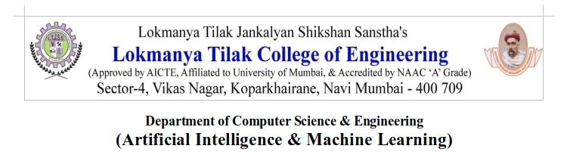
Major Project-1 Presentation-I B.E. (CSE-AI&ML) Sem - VII
2024-25

Slide 2

LSTM Modelling for Rice growth Optimization
Group members:
Aakash Chari 112
Jalaluddin Ansari 122
Jishnu Nair 123
Manthan Sawant 127
Name of Project Guide:
Prof. Chaitrali Chaudhari

Slide 3
Presentation Outline
Abstract
Introduction
Literature Survey
Limitations of Existing system
Problem Statement and Objective
Scope
Proposed System
Implementation
References

Slide 4
ABSTRACT
This project aims to optimize rice seedling growth through an intelligent growth chamber utilizing advanced environmental control systems and machine learning techniques.
By integrating sensors for temperature, humidity, light, CO2, and soil moisture with a microcontroller, the chamber precisely regulates conditions to accelerate seedling growth and enhance quality.
Data collected will be analyzed using LSTM models to fine-tune environmental parameters, offering a scalable solution for efficient rice cultivation even in non-traditional growing regions.

Slide 5
INTRODUCTION
Rice cultivation is a critical agricultural practice, yet traditional methods face challenges in efficiency and scalability.
This project explores the development of an intelligent growth chamber designed to optimize rice seedling growth through precise control of environmental conditions.
By integrating sensors and machine learning algorithms, the chamber aims to accelerate seedling development and enhance overall quality, potentially revolutionizing rice farming practices and extending cultivation to regions with unsuitable climates.

Slide 6
LITERATURE SURVEY
Sr. No | Authors | Title of the paper & year of publ.(Old to recent ) | Major contributions/ Methods Used | Gaps
1 | Suiyun Tan Jingbin Liu, Henghui Lu, Maoyang Lun | M L Approaches for Rice Seedling Growth Stages Detection- 2022 | Detection of rice growth through UAV captured images | Challenges in precise detection of rice seedling
2 | Zachary C. Lipton | A Critical Review of Recurrent Neural Networks for Sequence Learning -2015 | Exploration of Capabailities and advantages of RNN | Limited exploration of RNN and lack of comparision with different models
3 | Chenchen Sun | Application of Smart Sensors to Monitor the Interactive Effects of Temperature and Lighting on Plant Growth in a Simulated Controlled Environment Facility -2005 | Exploration of plant growth in controlled environments using smart sensors to analyze temperature light and CO 2 levels | There was a need of more data to make more efficient algorithms
4 | Yasushi Hashimoto, Haruhiko Murase, Tetsuo Morimoto, and Toru Torii | Intelligent systems for agriculture in Japan-2001 | Advancement of AI in agriculture | More advancement in genetic algorithms and neural networks

Slide 7
LIMITATIONS OF EXISTING SYTEM
Traditional cultivation methods are heavily dependent on unpredictable weather conditions and seasonal changes, affecting seedling growth and crop yield.
Conventional systems often lead to inefficient use of resources like water, nutrients, and energy, resulting in higher costs and environmental impact.
Current systems may lack the capability to collect and analyze detailed growth data, making it difficult to make informed decisions for improving cultivation practices.

Slide 8
PROBLEM STATEMENT & OBJECTIVES
Develop an intelligent growth chamber equipped with IoT-based control systems.
Integrate the chamber with an LSTM model to predict and optimize environmental conditions for rice seedling growth.
Leverage deep learning to enhance growth outcomes while minimizing resource usage, advancing precision agriculture.
Evaluate the practical application of the system in real-world agricultural settings.
Explore the scalability of the system for broader commercial use.

Slide 9
SCOPE
Multi-Crop Adaptation:
Expand the system to support different crops beyond rice, adapting the intelligent chamber's parameters to suit various agricultural needs.
Enhanced AI Models:
Integrate advanced AI techniques, such as convolutional neural networks (CNNs) and reinforcement learning, to further optimize growth conditions and decision-making processes.
Integration with Blockchain:
Use blockchain technology for secure and transparent data logging, enabling traceability and trust in agricultural practices.

Slide 10
PROPOSED SYSTEM
Intelligent Growth Chamber:
Components: Sensors (temperature, humidity, light, CO2, soil moisture), actuators, IoT device (Raspberry Pi/Arduino).
Software: Python-based control algorithms, real-time data collection via IoT.
Data Collection & Preprocessing:
Gather and clean time-series data. Prepare dataset for LSTM model training.
LSTM Model Development:
Tools: TensorFlow/ PyTorch.
Process: Train and optimize the LSTM model to predict growth based on environmental data.
Optimization & Real-Time Control:
Use algorithms (e.g., Genetic Algorithms) to optimize environmental
conditions. Implement IoT-driven real-time environmental control.
Testing & Validation:
Conduct experiments to validate system effectiveness.

Slide 11
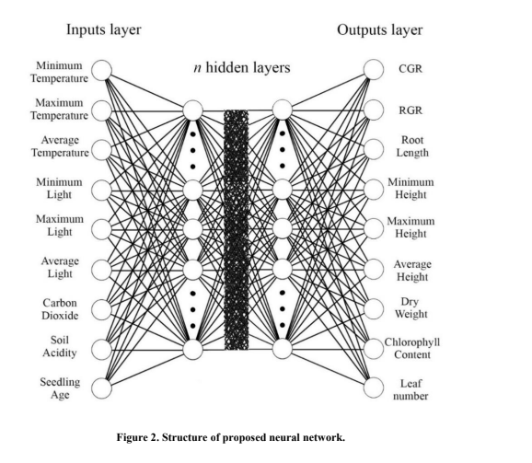
PROPOSED SYSTEM
Neural Network Diagram

Slide 12
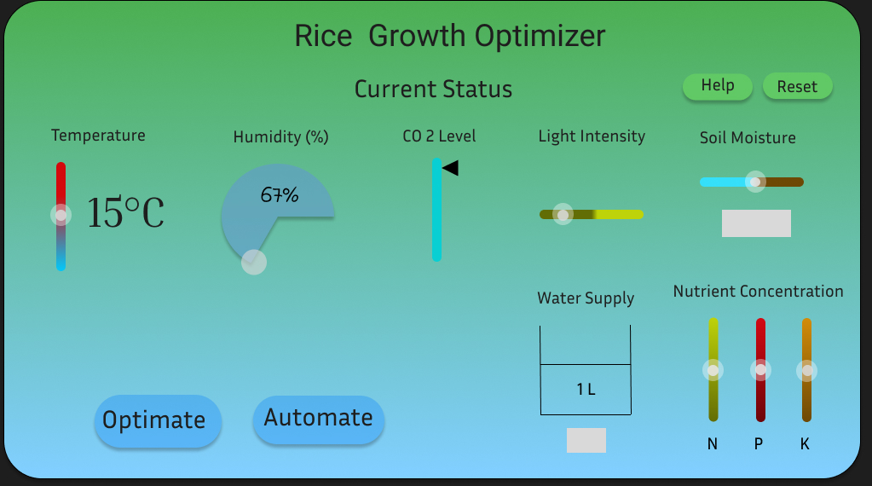
IMPLEMENTATION

Slide 13
REFERENCES
[1] B. Alhnaity, S. Pearson, G. Leontidis, and S. Kollias, “Using deep learning to predict plant growth and yield in greenhouse environments,” International Symposium on Advanced Technologies and Management for Innovative Greenhouses, vol. 1296, pp. 425-432, 2019.
[2] K. Alibabaei, P. D. Gaspar, and T. M. Lima, “Crop yield estimation using deep learning based on climate big data and irrigation scheduling,” Energies, vol. 14, no. 11, 2021.
[3] K. Anguraj, B. Thiyaneswaran, G. Megashree, J. P. Shri, S. Navya, and J. Jayanthi, “Crop recommendation on analyzing soil using machine learning,” Turkish Journal of Computer and Mathematics Education, vol.12, no. 6, pp. 1784-1791, 2021.
[4] H. C. D. Castro Filho, O. A. D. Carvalho Júnior, O.L. F. D. Carvalho, P. P. D. Bem, R. D. S. D. Moura, A.O. D. Albuquerque, and R. A. T. Gomes, “Rice crop detection using LSTM, Bi-LSTM, and machine learning models from sentinel-1 time series,” Remote Sensing, vol. 12, no. 16, 2020.
[5] S. Chaithanya, A. Punith Raj, N. Rajeshrahul, H.Sujatha, and D. Veena, “Rice crop yield prediction using recurrent neural networks,” International Research Journal of Engineering and Technology (IRJET), vol. 7,2020.
[6] A. Chandgude, N. Harpale, D. Jadhav, P. Pawar, and S. M. Patil, “A review of machine learning algorithm used for a crop monitoring system in agriculture,” International Research Journal of Engineering and Technology (IRJET), vol. 5, no. 4, 2018.

Slide 14
Thank You!

